Slide 1
Presentation By :
Areeba Ali &
Shandana Shah
BFS & DFS Algorithm

Slide 2
What is a Graph?
A graph is a data structure used to represent relationships or connections between objects.
Graph consists of:
Vertices (Nodes)
Edges (Links)

Slide 3
To explore a graph, we use graph traversal algorithms. Two of the most fundamental traversal algorithms are:
Breadth-First Search (BFS)
Depth-First Search (DFS)

Slide 4
Breadth-First Search (BFS) :
BFS is a level-order traversal of a graph.
It explores all neighbors of a vertex before moving deeper.
Think of it like ripple waves in water:
you drop a stone and the waves move outward equally —
“first nearest nodes, then next nearest nodes, then the far ones”.

Slide 5
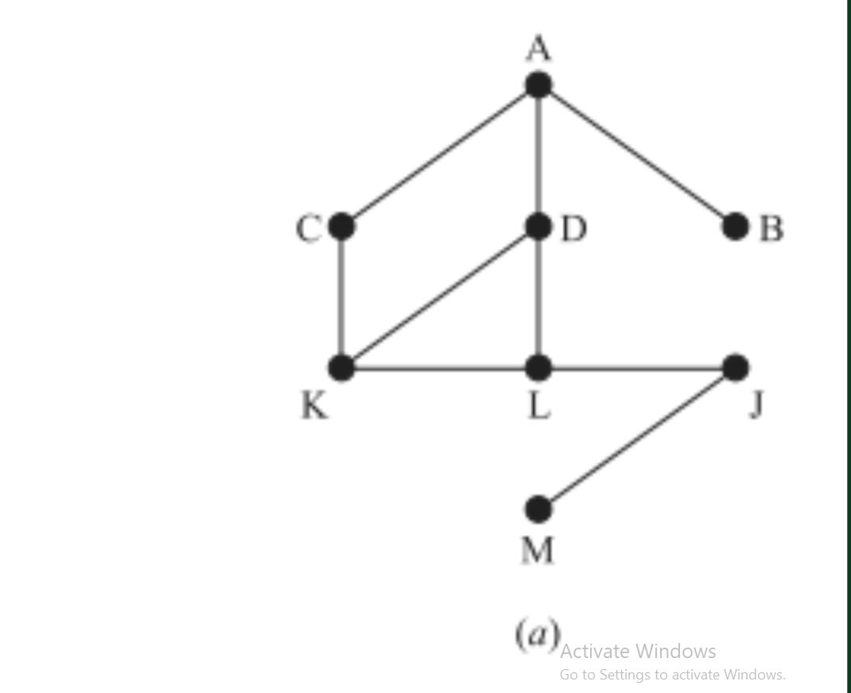
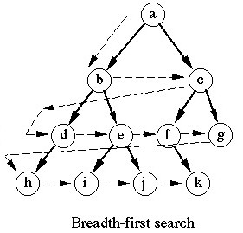
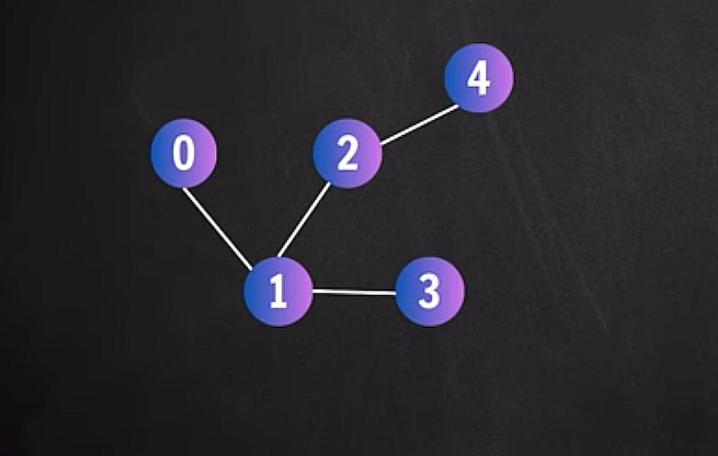
Example To Explain BFS :

Slide 6
How it Work :
BFS always explores nodes in the order of their distance from the starting node.
It visits nodes:
First the start node
Then all neighbors (distance 1)
Then all neighbors of neighbors (distance 2)
And keeps going level by level

Slide 7
Data Structure Used:
BFS uses a queue because a queue follows FIFO (First In, First Out).
The earliest discovered node is processed first — this is what creates the “levels.”
QUEUE

Slide 8
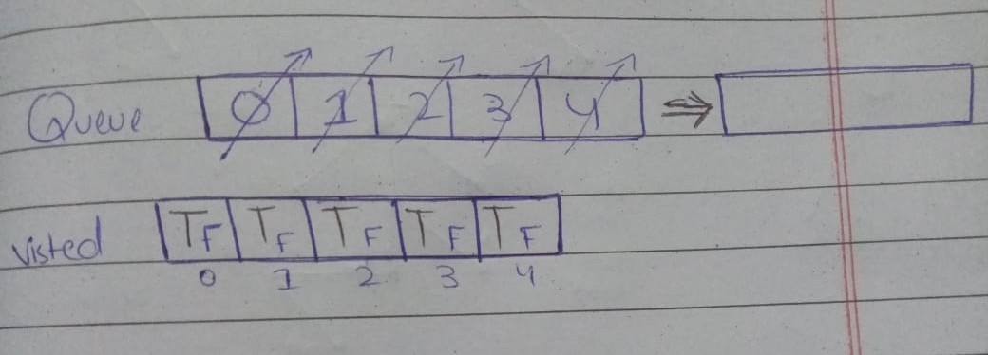
Implementation :

Slide 10
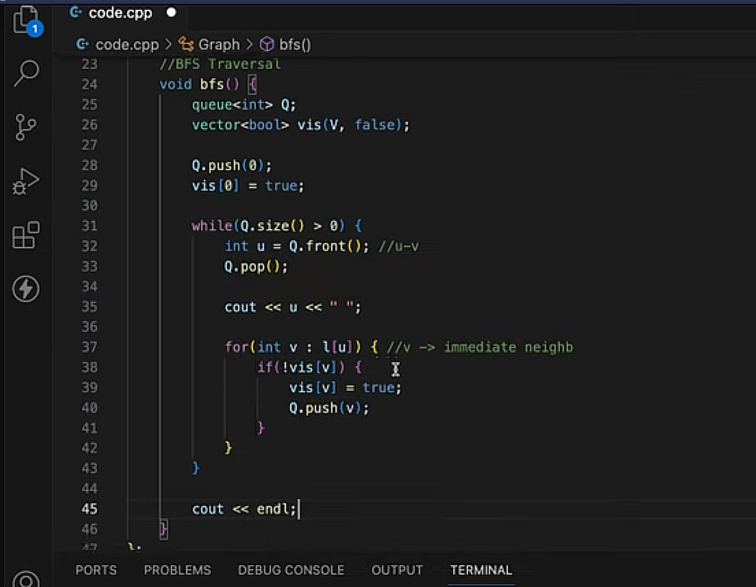
Code :

Slide 11
Time & Space Complexity :
Time complexity:
Time Complexity = O(V + E)
Where:
V = number of vertices (nodes)
E = number of edges (connections)
Space complexity:
Space Complexity = O(V + E)

Slide 12
Where BFS is USE :
Finding shortest path in unweighted graph
Level Order Traversal in Trees
Finding Connected Components
Search web pages level by level.
Social Networks (Friend Suggestions)

Slide 13
Thank You !

